Slide 1


Tree leaf recognition
Rufus Roisch & Hedda Bonatz Machine Learning with Tensorflow SoSe 2023

Slide 2
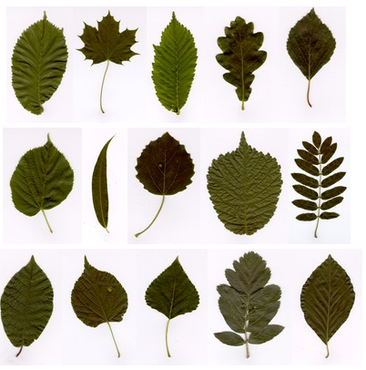
Data
15 tree leaf types with 75 images each → 1125 images
RGB images
Single leaf on a white background → Bias
Preprocessing:
Resize the images (300x150x3)

Slide 3
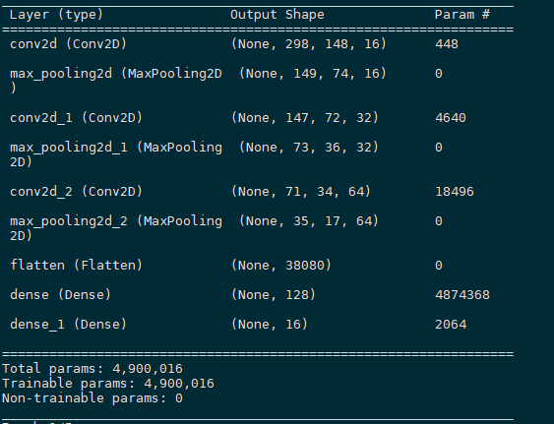
Basemodel
5 epochs
→ Validation loss: 0.5 | Validation accuracy: 0.88

Slide 4
Basemodel adjustments
Epochs | Convs | Pooling | Optimizer | Loss
5 | 3x (3x3 ) | 3x () | Adam | softmax
9 | 1x () | 1x () | Adam | softmax
9 | 2x | 2x () | Adam | softmax
9 | 3x () | 3x () | Adam | softmax
9 | 3x () | 3x () | Adam | softmax
Changes:
Epoch: For 9 epochs we get the best performance (Acc: 0.85 | Loss: 0.63) → for more epochs the model is overfitting
Number of layers (9 epochs):
1 Conv + 1 Pool: validation loss: 0.54 | validation accuracy: 0.83
2 Conv + 2 Pool: validation loss: 0.53 | validation accuracy: 0.89 → better
3 Conv + 3 Pool: validation loss: | validation accuracy: 0.9
4 Conv + 4 Pool: validation loss: 0.47 | validation accuracy: 0.87 (less epochs than 9 improve the performance again)
Performance improves with more layers
Increasing the size of max pooling decreases the accuracy
3x3 max pooling improves accuracy (validation loss. 0.34 | validation accuracy: 0.91)
Average pooling decreases the performance
Optimizer:

Slide 5
Black and White Images
Validation loss: 0.62 | Validation accuracy: 0.81 (5 epochs, max pool 2x2)
→ Color seems to be an important characteristic for the recognition of tree leaves

Slide 6
Augmentation

Slide 7
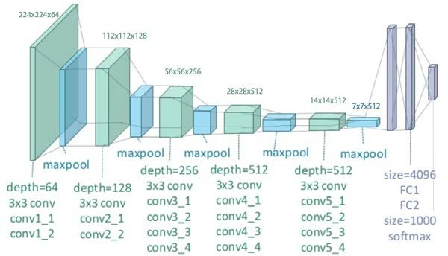
Transfer Learning with VGG19
Yang et al. 2018

Slide 8
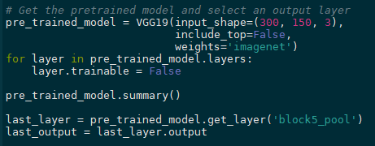
Implementation VGG19

Slide 9
Difficulties
Structured working
Setting tensorflow on private machine (GPU not working)

Slide 10
Outlook
Training and testing the model with a larger variety of images

